Slide 1
Development of order-limited samples on the sphere
Salman Nadeem (M.S. Electrical Engineering)
Supervised by Dr. Zubair Khalid (Associate Professor, Department of Electrical Engineering)
Notes:
NOTE:
To change the image on this slide, select the picture and delete it. Then click the Pictures icon in the placeholder to insert your own image.

Slide 2
Contents
Motivation
Mathematical Background
Problem Under Consideration
Proposed Formulation
Order-limiting Gauss-Legendre Samples
Order-limiting Optimal Dimensionality Samples
Summary

Slide 3
Motivation
Notes:
NOTE:
To change the image on this slide, select the picture and delete it. Then click the Pictures icon in the placeholder to insert your own image.

Slide 4
Signals on Sphere
What are signals?
Objective of Signal Processing techniques
Signal Processing domains
Why spherical signal processing?

Slide 5
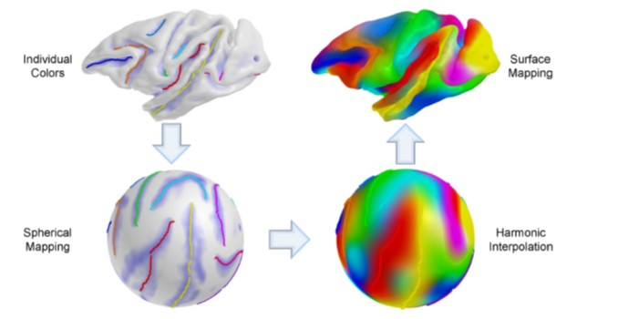
Applications of Spherical Signal Processing
Cortical Surface Representation

Slide 6
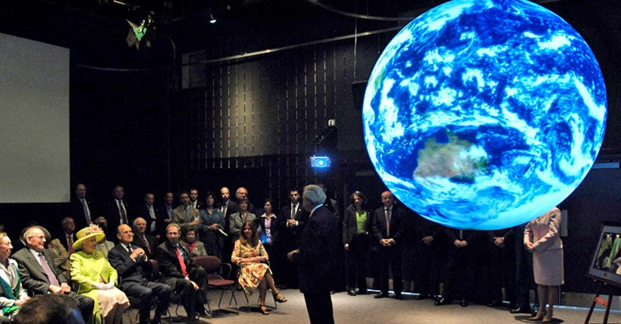
Applications of Spherical Signal Processing
Climate data displayed on NASA global display system

Slide 7
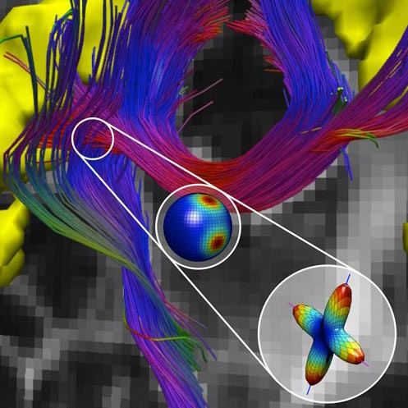
Applications of Spherical Signal Processing
White matter fibers in brain voxels encoded by spherical geometrics

Slide 8
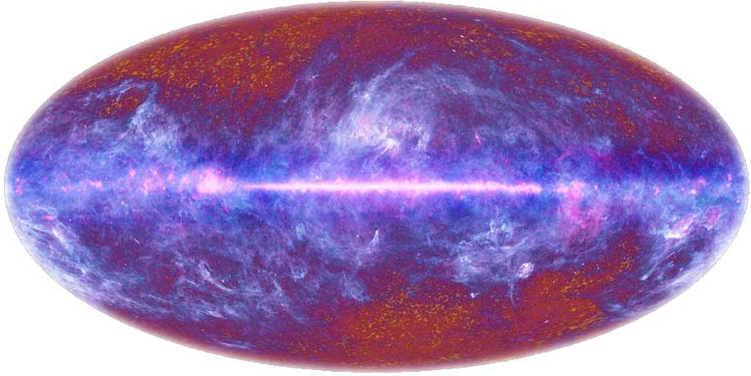
Applications of Spherical Signal Processing
Cosmic microwave background radiation map

Slide 9
Mathematical background
Notes:
NOTE:
To change the image on this slide, select the picture and delete it. Then click the Pictures icon in the placeholder to insert your own image.

Slide 10
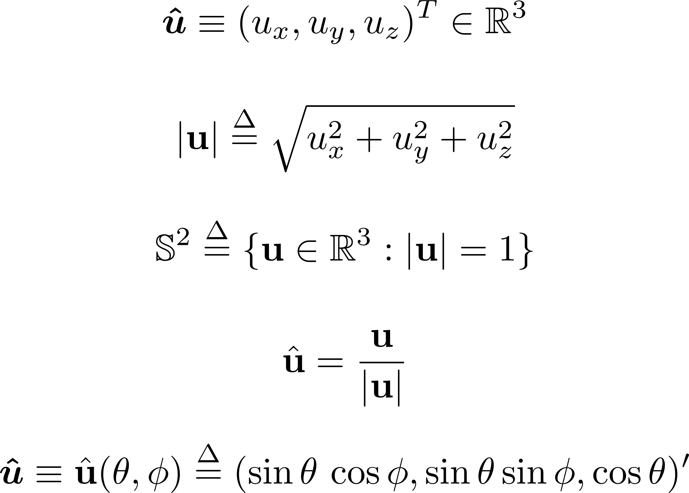
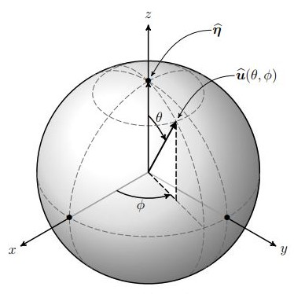
The Spherical Coordinate System
Notes:
Figure credits

Slide 11
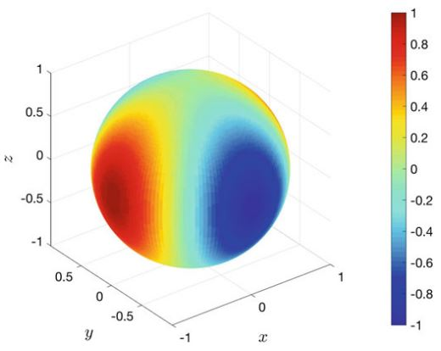
Functions on Sphere

Slide 12
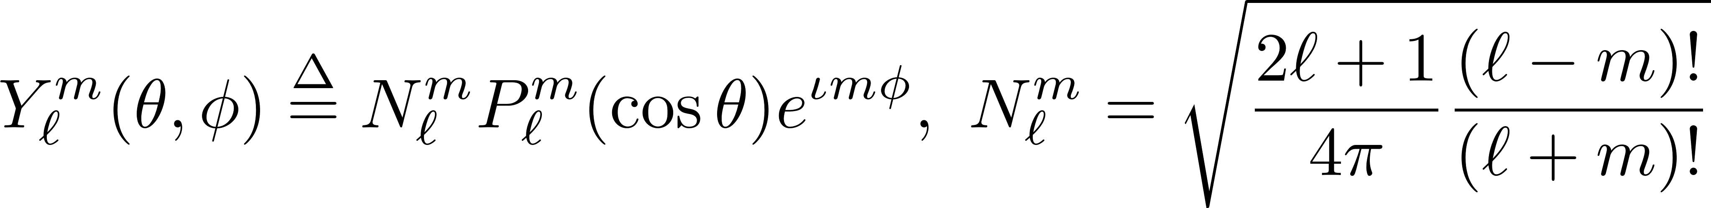
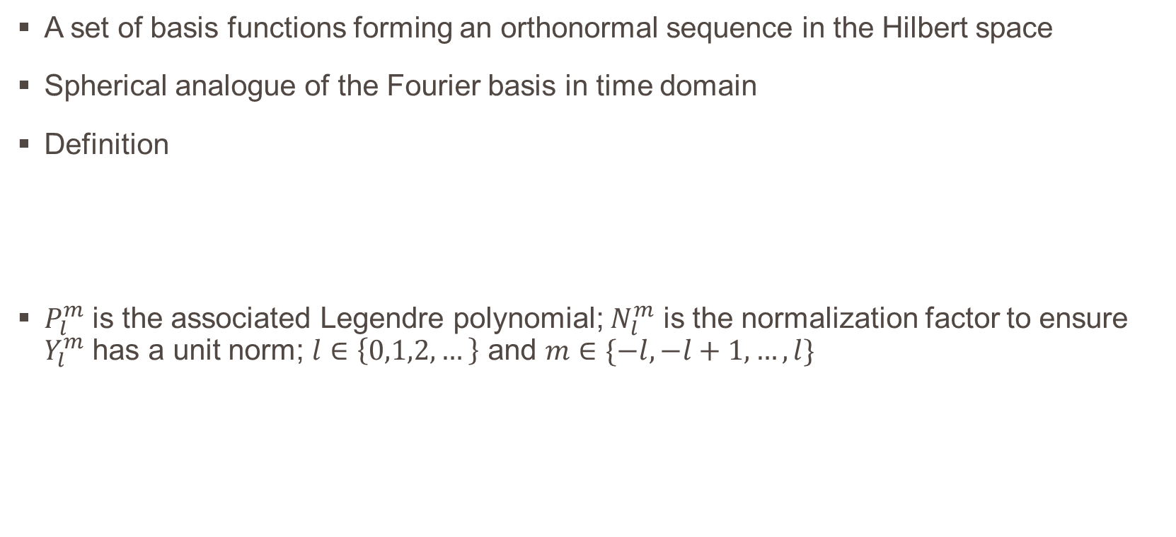
Spherical Harmonics
A set of basis functions forming an orthonormal sequence in the Hilbert space
Spherical analogue of the Fourier basis in time domain
Definition
$P_{l}^{m}$ is the associated Legendre polynomial; $N_{l}^{m}$ is the normalization factor to ensure $Y_{l}^{m}$ has a unit norm; $l∈\left\{0,1,2,…\right\}$ and $m∈\{−l,−l+1,…,l\}$

Slide 13
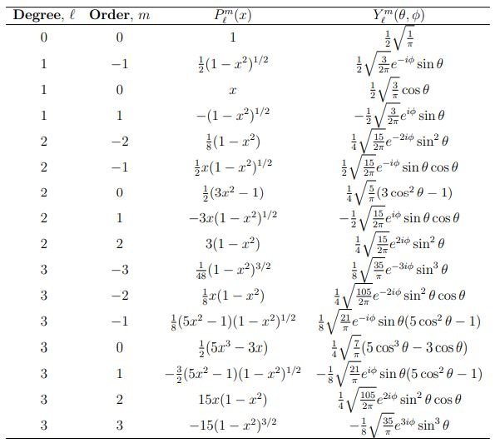
Some examples of SH basis functions
Notes:
Table credits

Slide 14
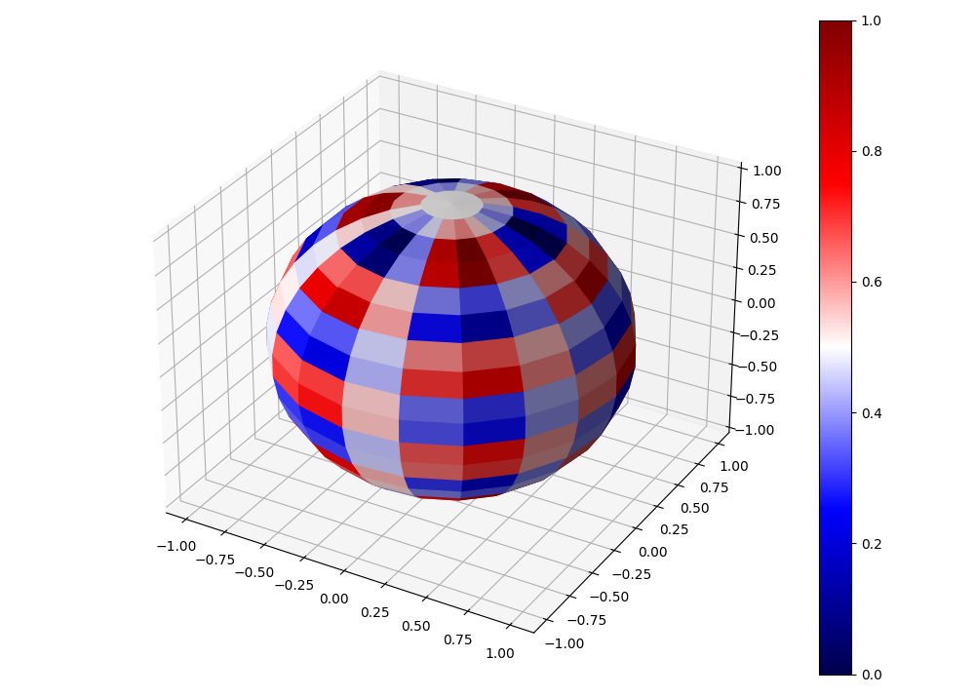
Spherical Harmonics Basis Function on Sphere
Notes:
Remove grid box; shading interp

Slide 15
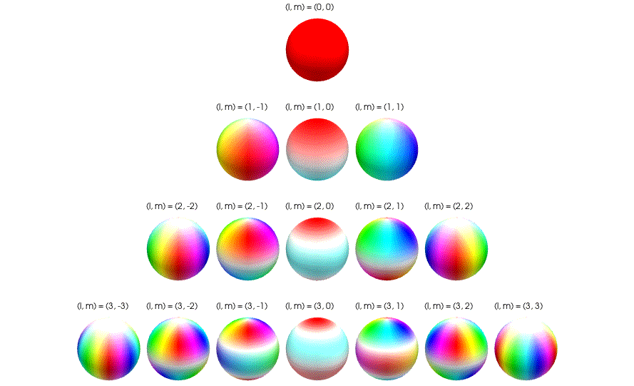
Spherical Harmonics Basis Function on Sphere
Notes:
Image Credits

Slide 16
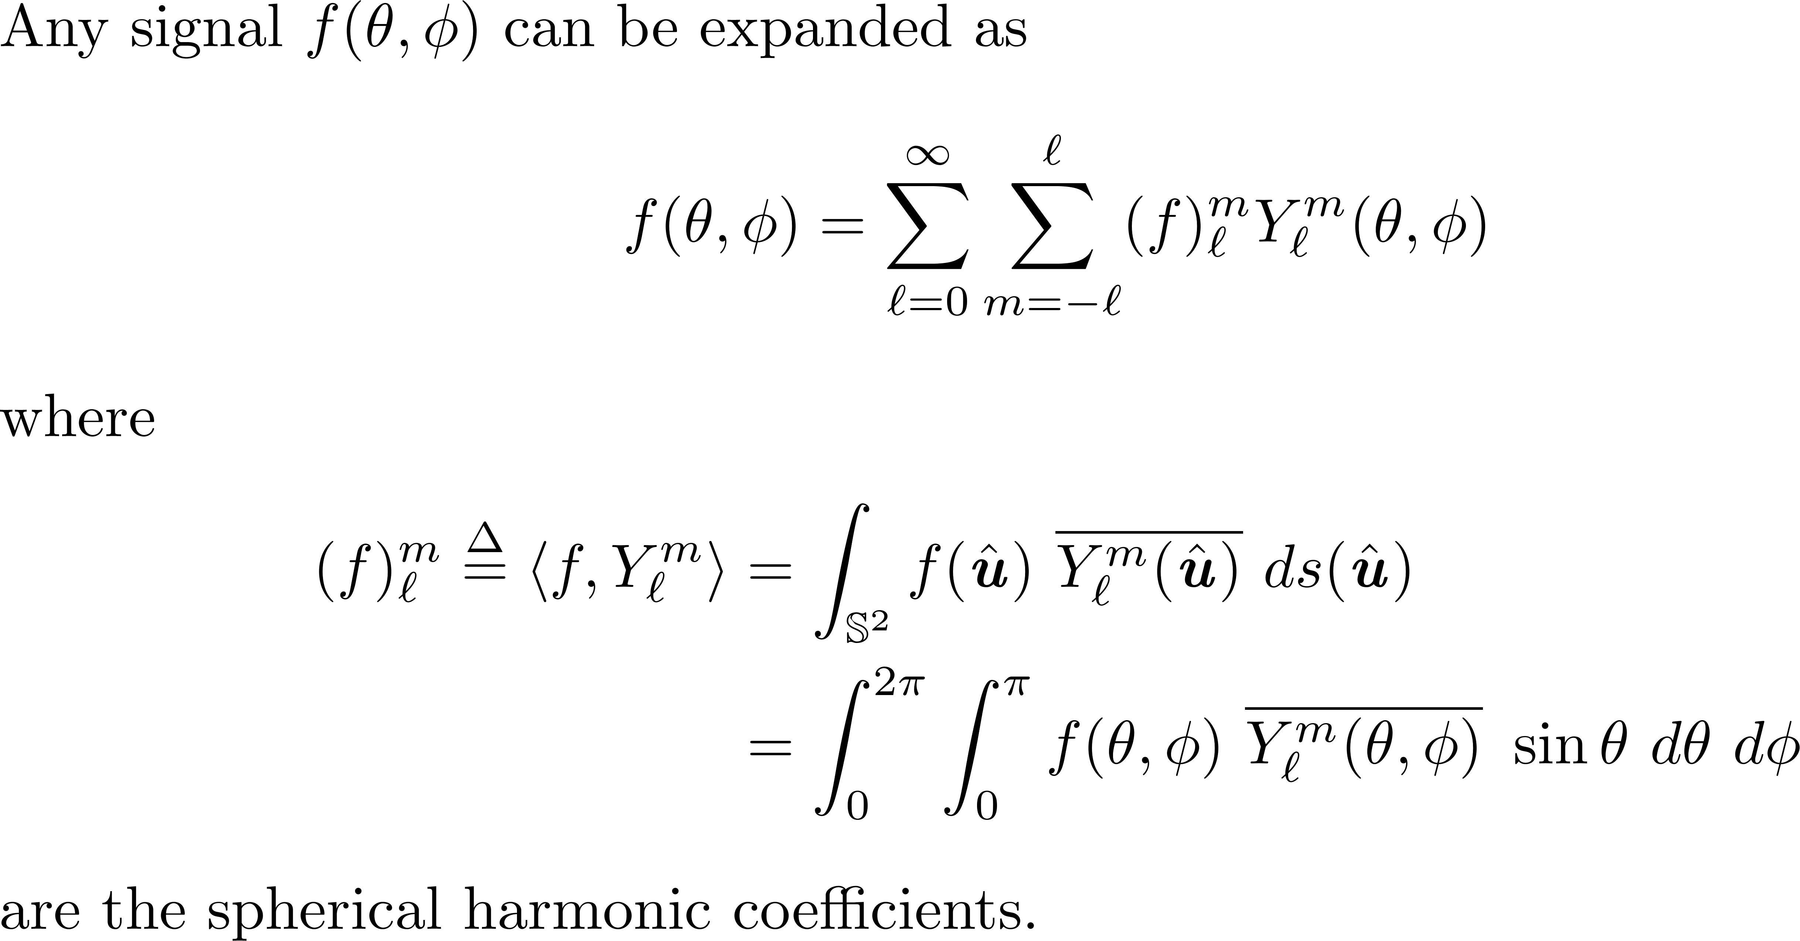
Spherical Harmonic Signal Expansion

Slide 17
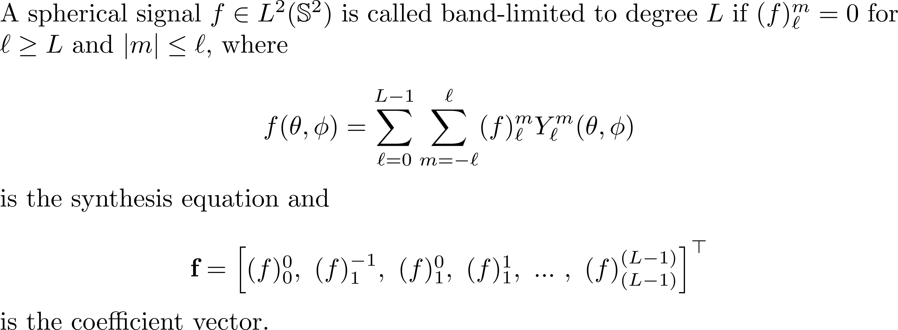
Band-limited Signals on the Sphere

Slide 18
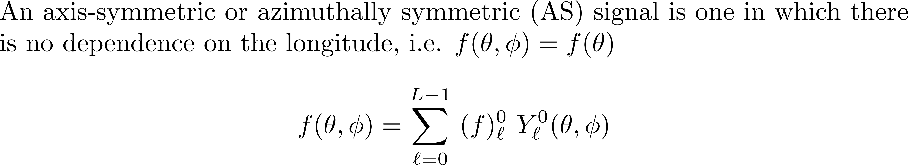
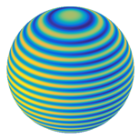
Azimuthally Symmetric Signals on the Sphere

Slide 19
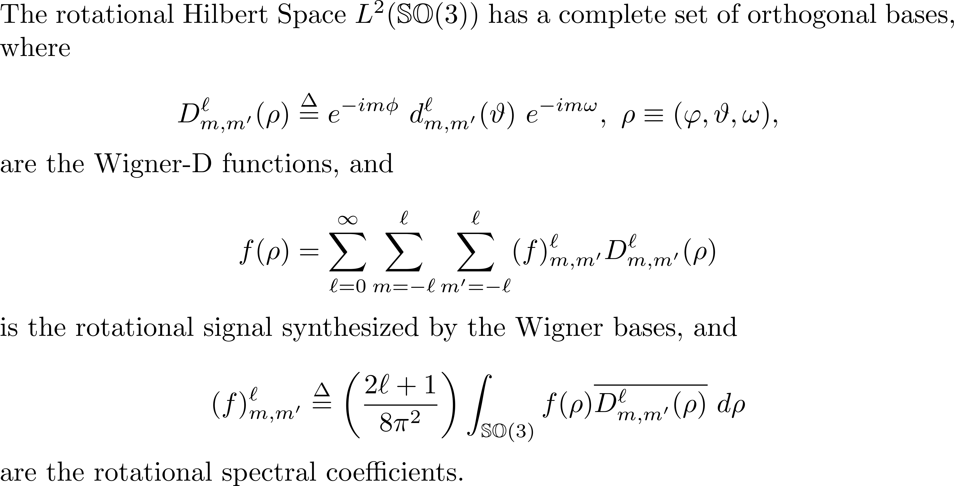
Wigner-D Functions

Slide 20
Problem under consideration
Notes:
NOTE:
To change the image on this slide, select the picture and delete it. Then click the Pictures icon in the placeholder to insert your own image.

Slide 21
Problem Statement
For many applications, reducing the number of samples required to represent a band-limited signal on a sphere is of fundamental importance.
To represent a band-limited signal exactly, sampling theorems on the sphere and their associated numerical algorithms are evaluated by two criteria:
The number of samples required.
The computational complexity.
Issues surrounding any precomputation.
This research work aims at proposing order-limited versions of two existing sampling schemes for nearly azimuthally symmetric signals

Slide 22
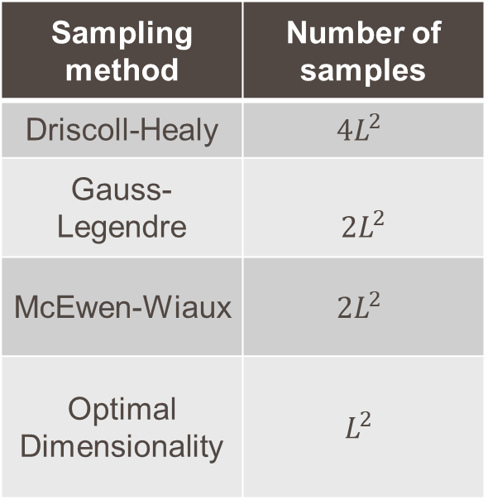
Literature Review
J. R. Driscoll and D. M. Healy, Jr., “Computing Fourier transforms and convolutions on the 2-sphere,” Adv. Appl. Math., vol. 15, no. 2, pp. 202-205, Jun. 1994.
W. Shukowsky, “A quadrature formula over the sphere with application to high resolution spherical harmonic analysis,” J. Geodesy, vol. 60, no. 1, pp. 1-14, Mar. 1986.
J. D. McEwen and Y. Wiaux, “A novel sampling theorem on the sphere,” IEEE Trans. Signal Process., vol. 59, no. 12, pp. 5876-5887, Dec, 2011.
Z. Khalid, R. A. Kennedy, and J. D. McEwen, “An optimal-dimensionality sampling scheme on the sphere with fast spherical harmonic transforms,” IEEE Trans. Signal Process., vol. 62, no. 17, pp. 4597-4610, Sept. 2014.
Sampling method | Number of samples
Driscoll-Healy | $${4L}^{2}$$
Gauss-Legendre | $${2L}^{2}$$
McEwen-Wiaux | $${2L}^{2}$$
Optimal Dimensionality | $$L^{2}$$
Notes:
Equiangular Iso-latitude Sampling Schemes
Gauss Legendre formula recheck
McEwen formula recheck

Slide 23
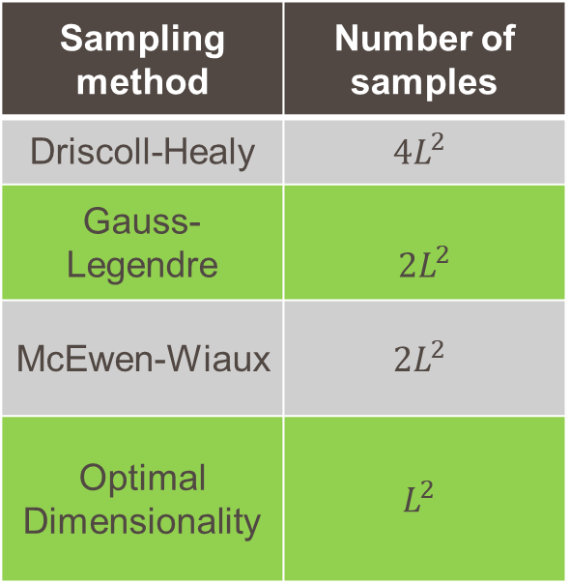
Literature Review
J. R. Driscoll and D. M. Healy, Jr., “Computing Fourier transforms and convolutions on the 2-sphere,” Adv. Appl. Math., vol. 15, no. 2, pp. 202-205, Jun. 1994.
W. Shukowsky, “A quadrature formula over the sphere with application to high resolution spherical harmonic analysis,” J. Geodesy, vol. 60, no. 1, pp. 1-14, Mar. 1986.
J. D. McEwen and Y. Wiaux, “A novel sampling theorem on the sphere,” IEEE Trans. Signal Process., vol. 59, no. 12, pp. 5876-5887, Dec, 2011.
Z. Khalid, R. A. Kennedy, and J. D. McEwen, “An optimal-dimensionality sampling scheme on the sphere with fast spherical harmonic transforms,” IEEE Trans. Signal Process., vol. 62, no. 17, pp. 4597-4610, Sept. 2014.
Sampling method | Number of samples
Driscoll-Healy | $${4L}^{2}$$
Gauss-Legendre | $${2L}^{2}$$
McEwen-Wiaux | $${2L}^{2}$$
Optimal Dimensionality | $$L^{2}$$

Slide 24
Proposed formulation
Notes:
NOTE:
To change the image on this slide, select the picture and delete it. Then click the Pictures icon in the placeholder to insert your own image.

Slide 25
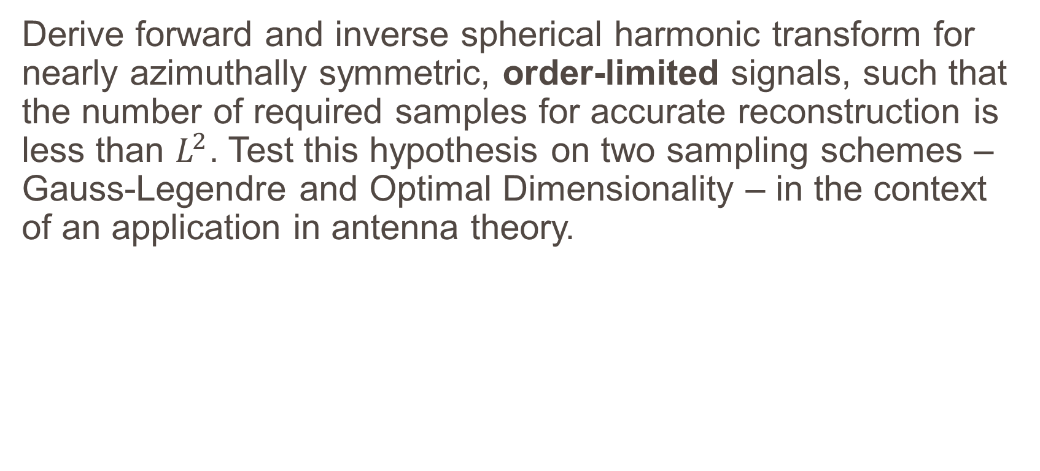
Proposal Statement
Derive forward and inverse spherical harmonic transform for nearly azimuthally symmetric, order-limited signals, such that the number of required samples for accurate reconstruction is less than $L^{2}$. Test this hypothesis on two sampling schemes – Gauss-Legendre and Optimal Dimensionality – in the context of an application in antenna theory.
Notes:
Mention sampling scheme (GL)

Slide 26
Order-limiting gauss-legendre samples
Notes:
NOTE:
To change the image on this slide, select the picture and delete it. Then click the Pictures icon in the placeholder to insert your own image.

Slide 27
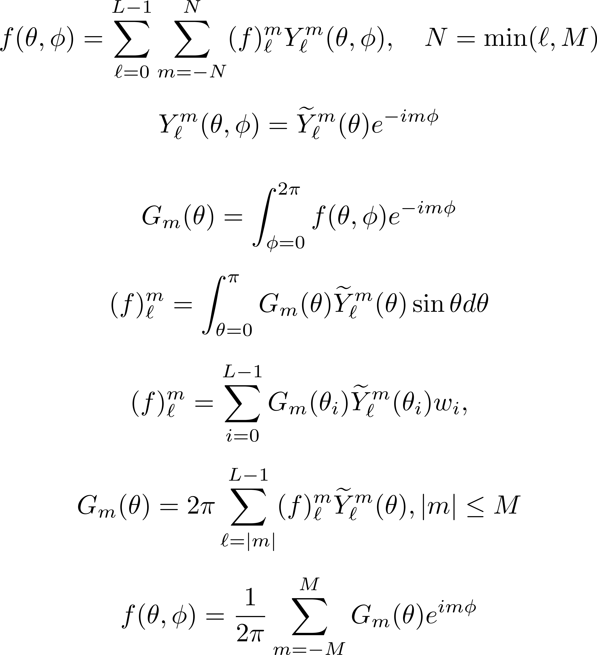
Mathematical Formulation
GL original
GL modified

Slide 28
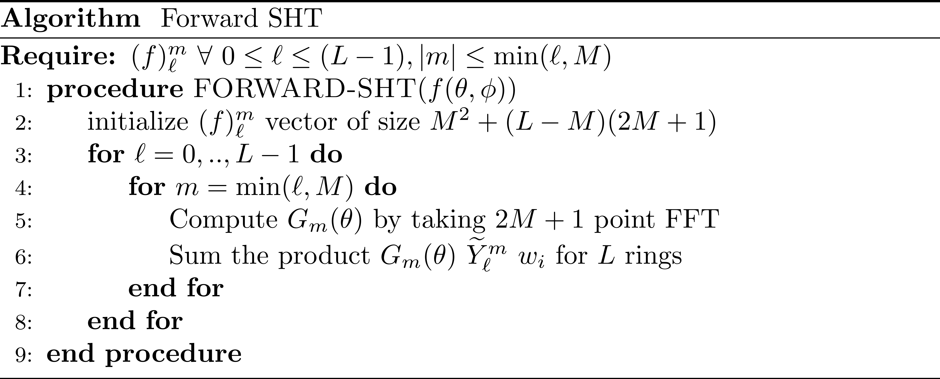
Algorithm (Forward)

Slide 29
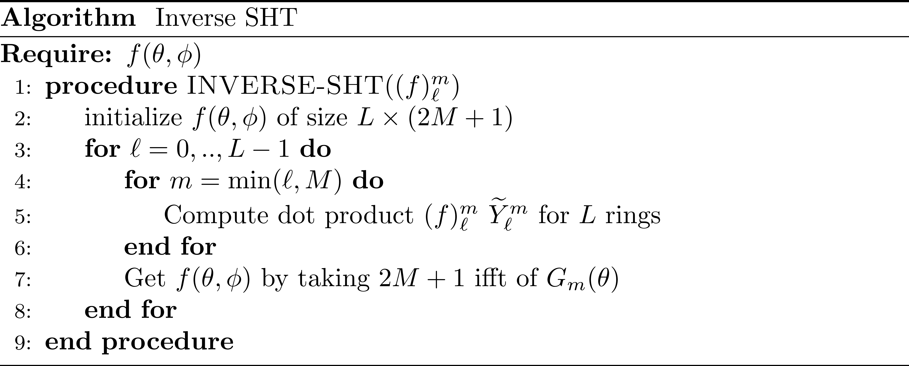
Algorithm (Inverse)

Slide 30
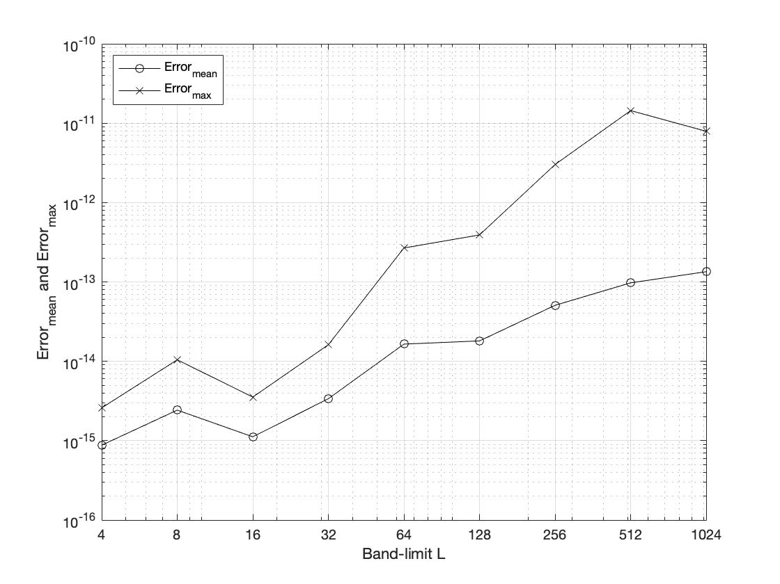
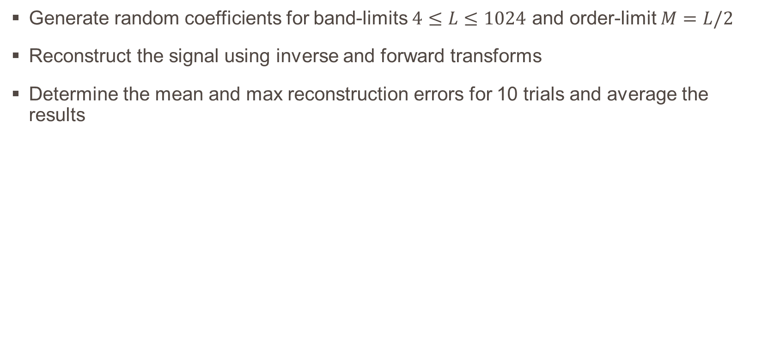
Numerical Accuracy Analysis
Generate random coefficients for band-limits $4≤L≤1024$ and order-limit $M=L/2$
Reconstruct the signal using inverse and forward transforms
Determine the mean and max reconstruction errors for 10 trials and average the results

Slide 31
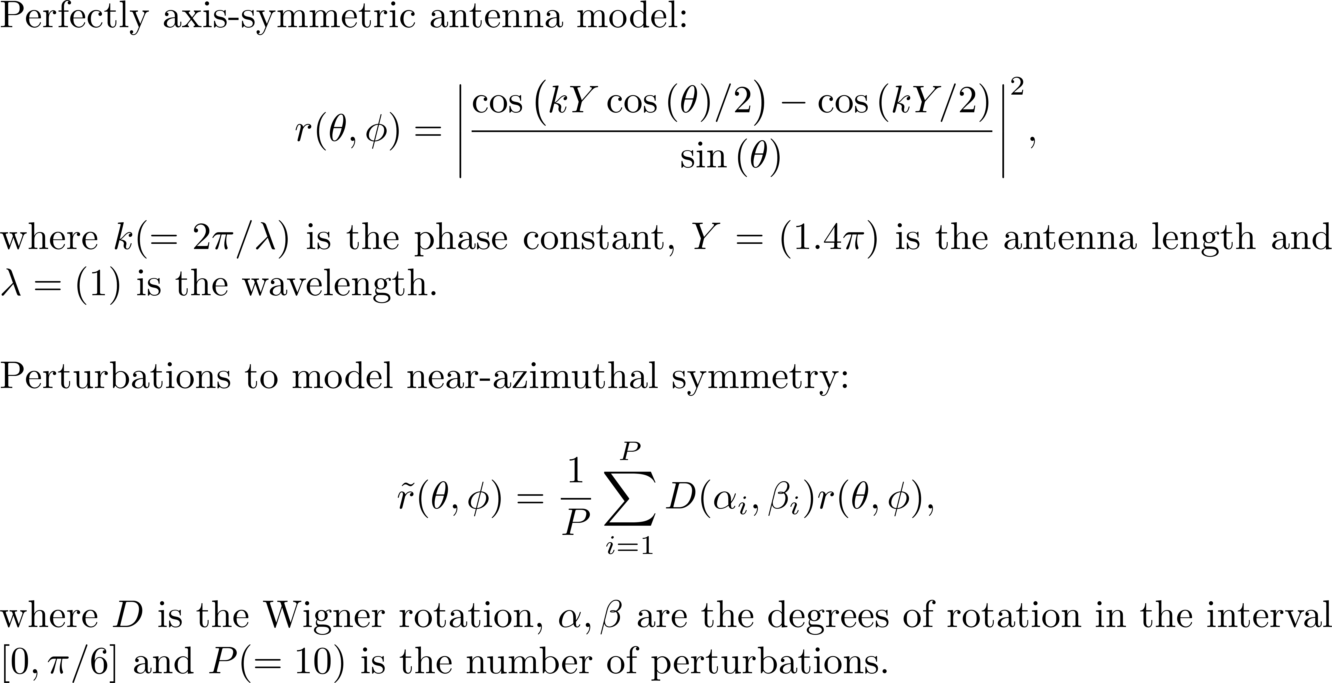
Application: Antenna Radiation Pattern

Slide 32
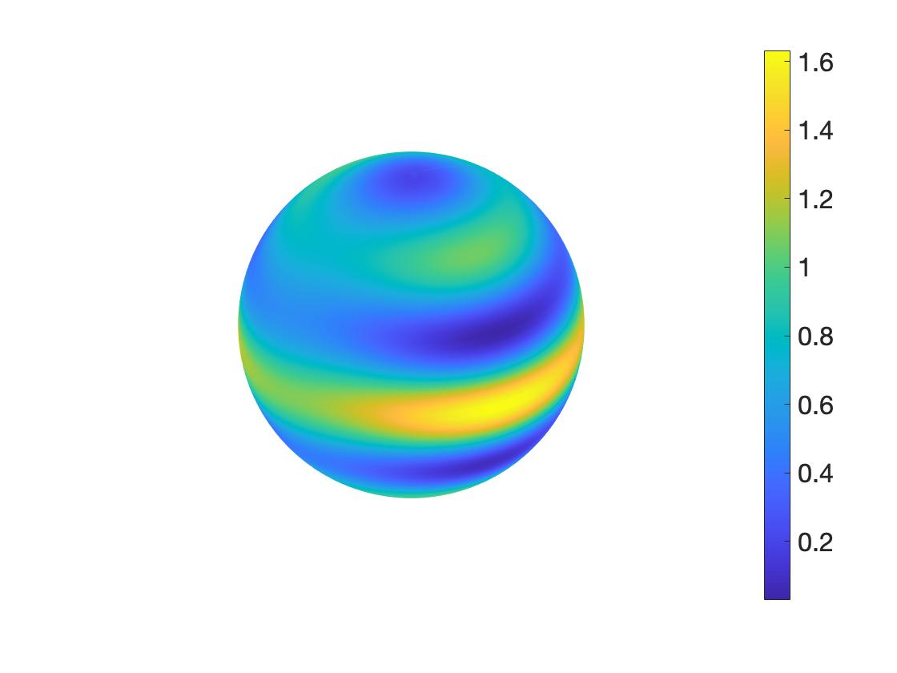
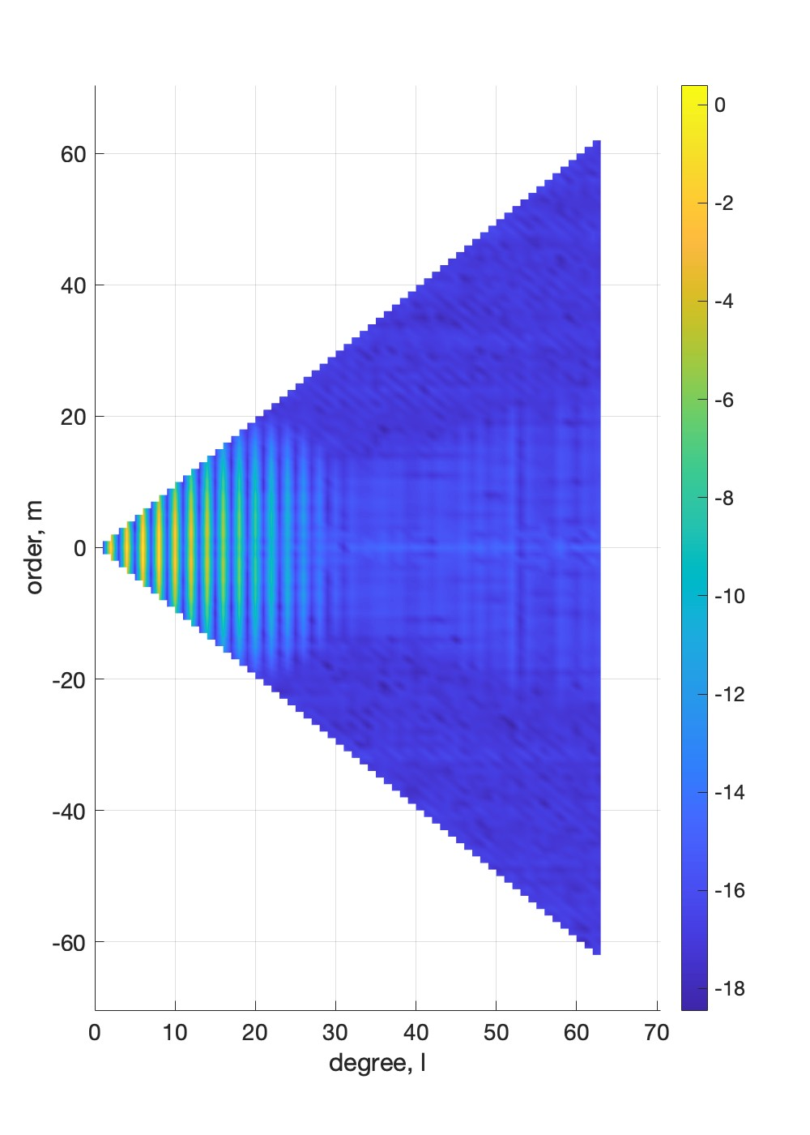
NAS Antenna Model (Spatial)
NAS Antenna Model (Spectral)

Slide 33
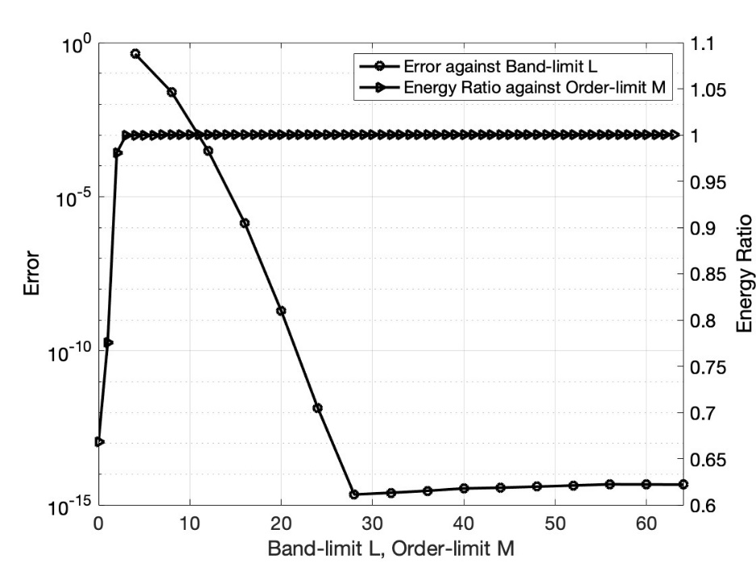
Effective Order-limit
Effective band-limit is when reconstruction error becomes constant
Effective order-limit is when energy ratio gets very close to 1
In this case, L_{eff} = 28, M_{eff} = 5
Signal reconstruction at L = 28, M = 5 results in error of the order 10⁻¹⁶

Slide 34
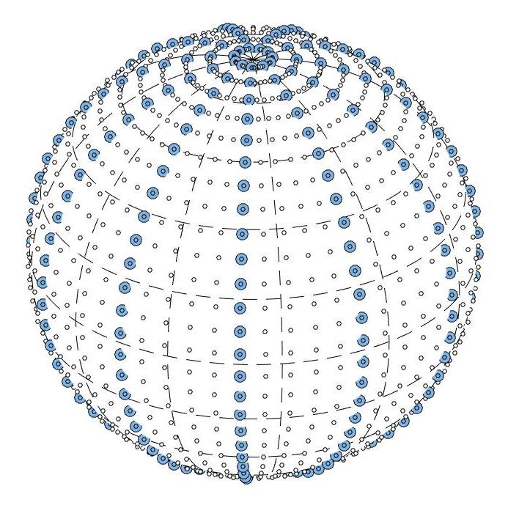
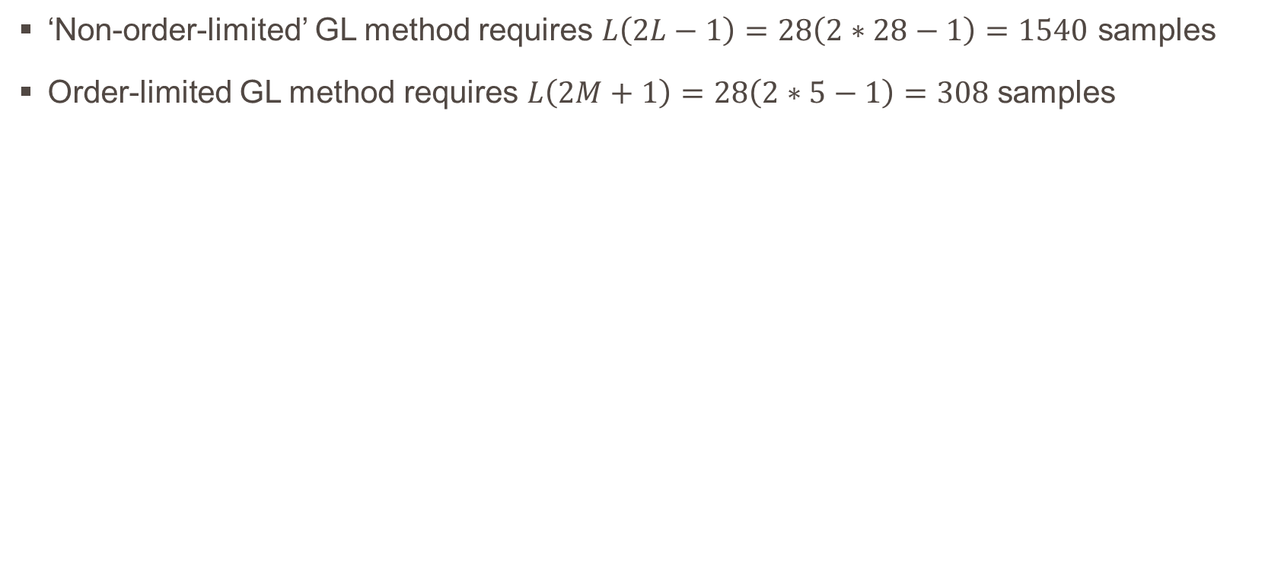
Number of samples reduced
‘Non-order-limited’ GL method requires $L\left(2L−1\right)=28\left(2∗28−1\right)=1540$ samples
Order-limited GL method requires $L\left(2M+1\right)=28\left(2∗5−1\right)=308$ samples

Slide 35
Order-limiting optimal dimensionality samples
Notes:
NOTE:
To change the image on this slide, select the picture and delete it. Then click the Pictures icon in the placeholder to insert your own image.

Slide 36
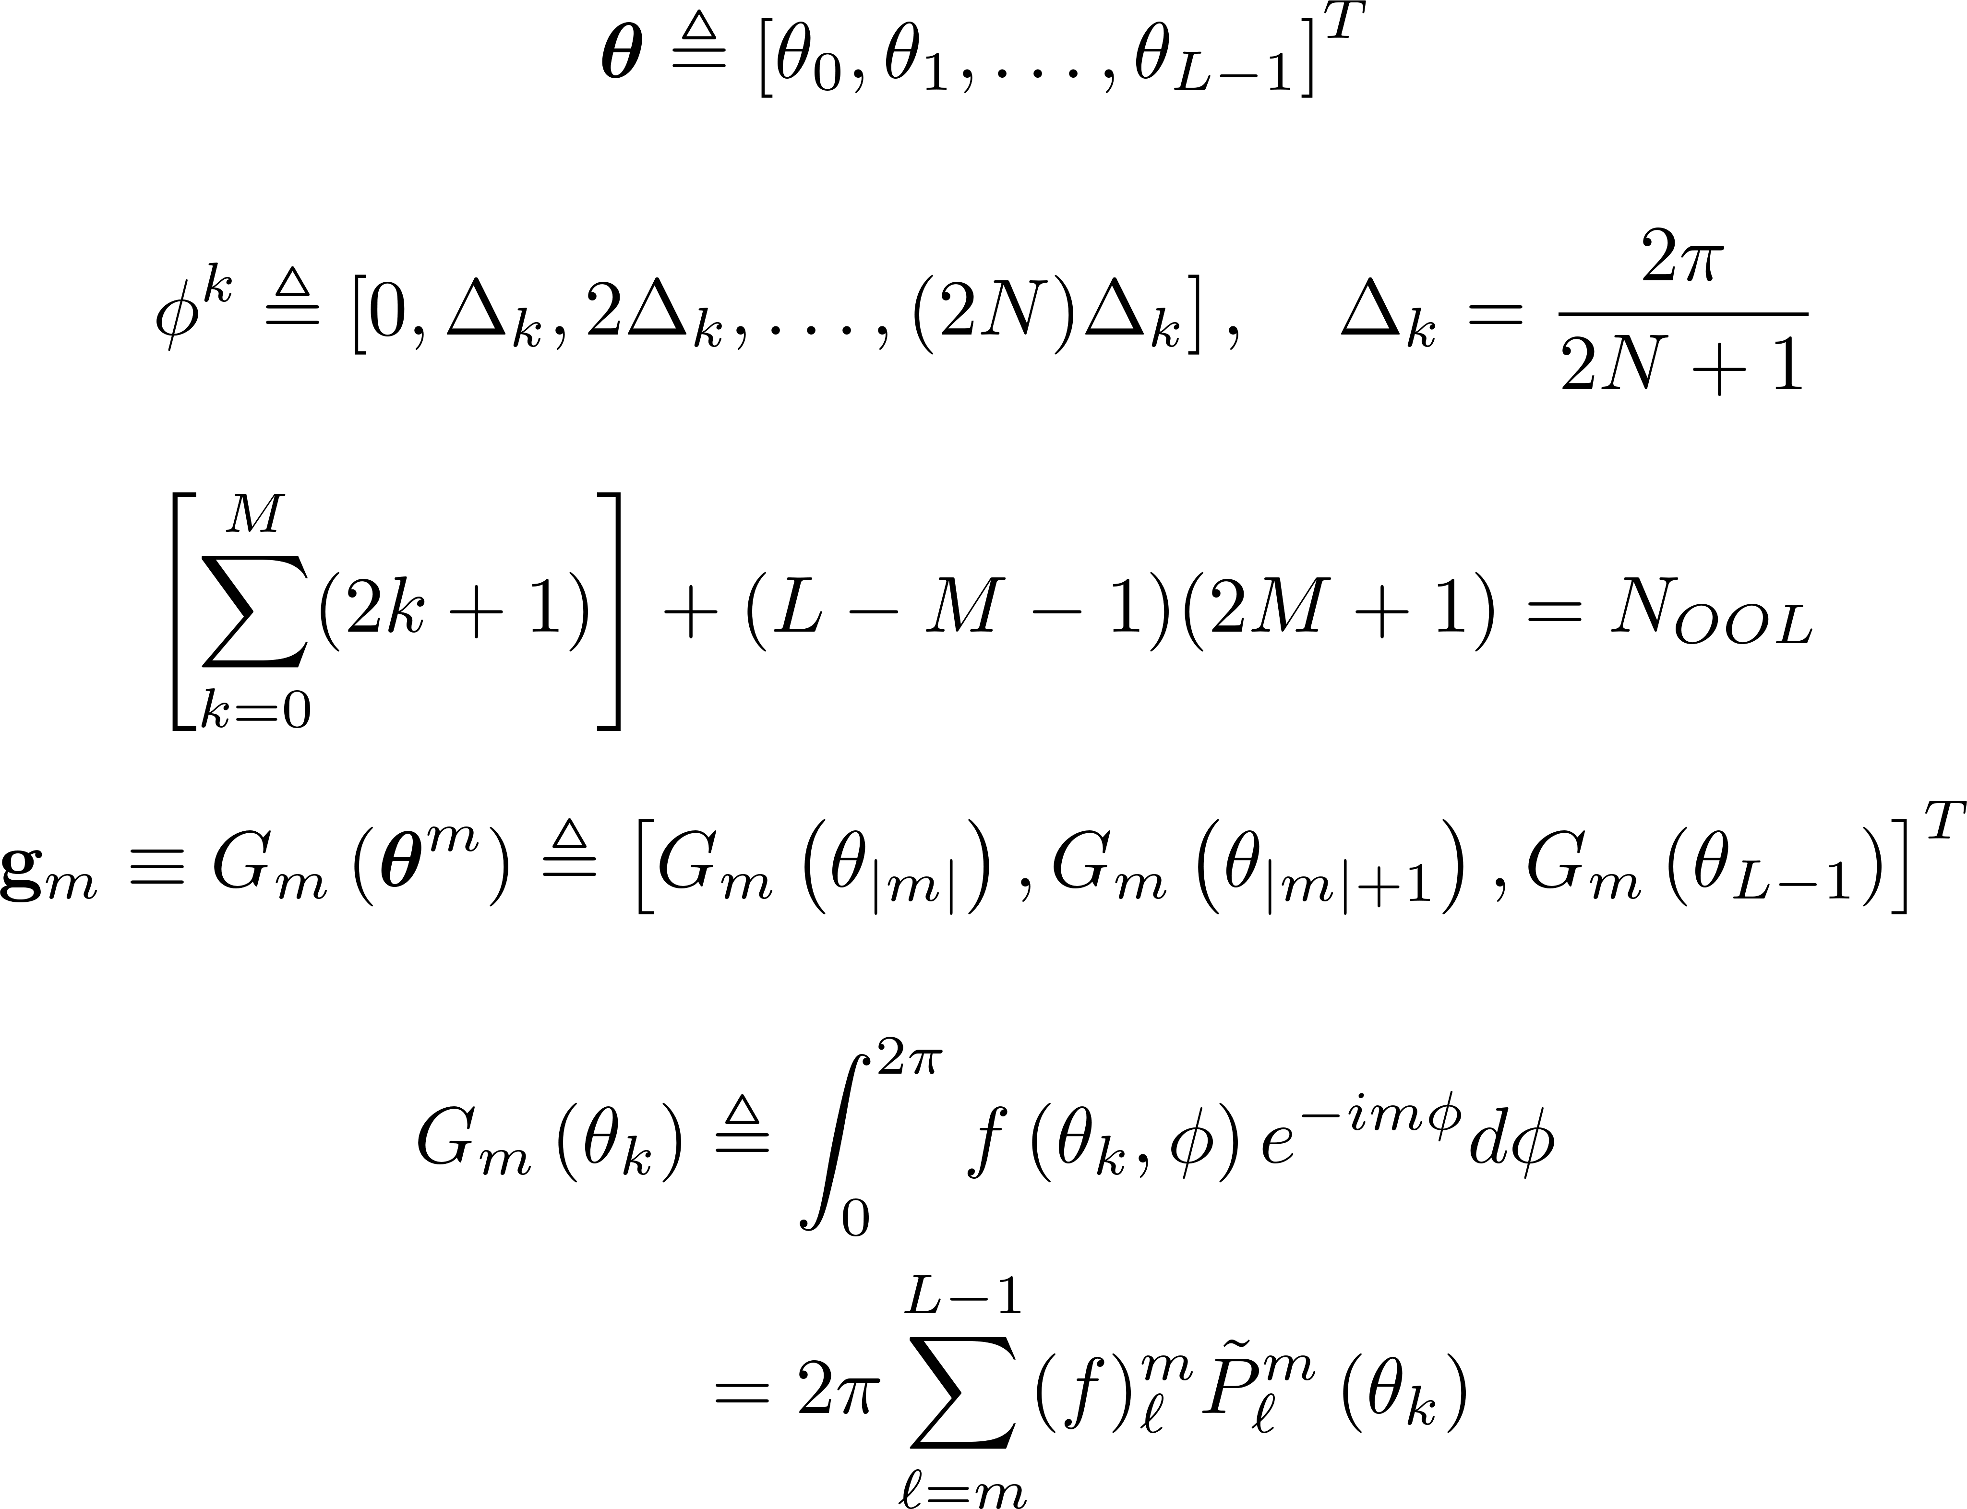
Mathematical Formulation
rings
samples
spatial
dimensionality
FFT

Slide 37
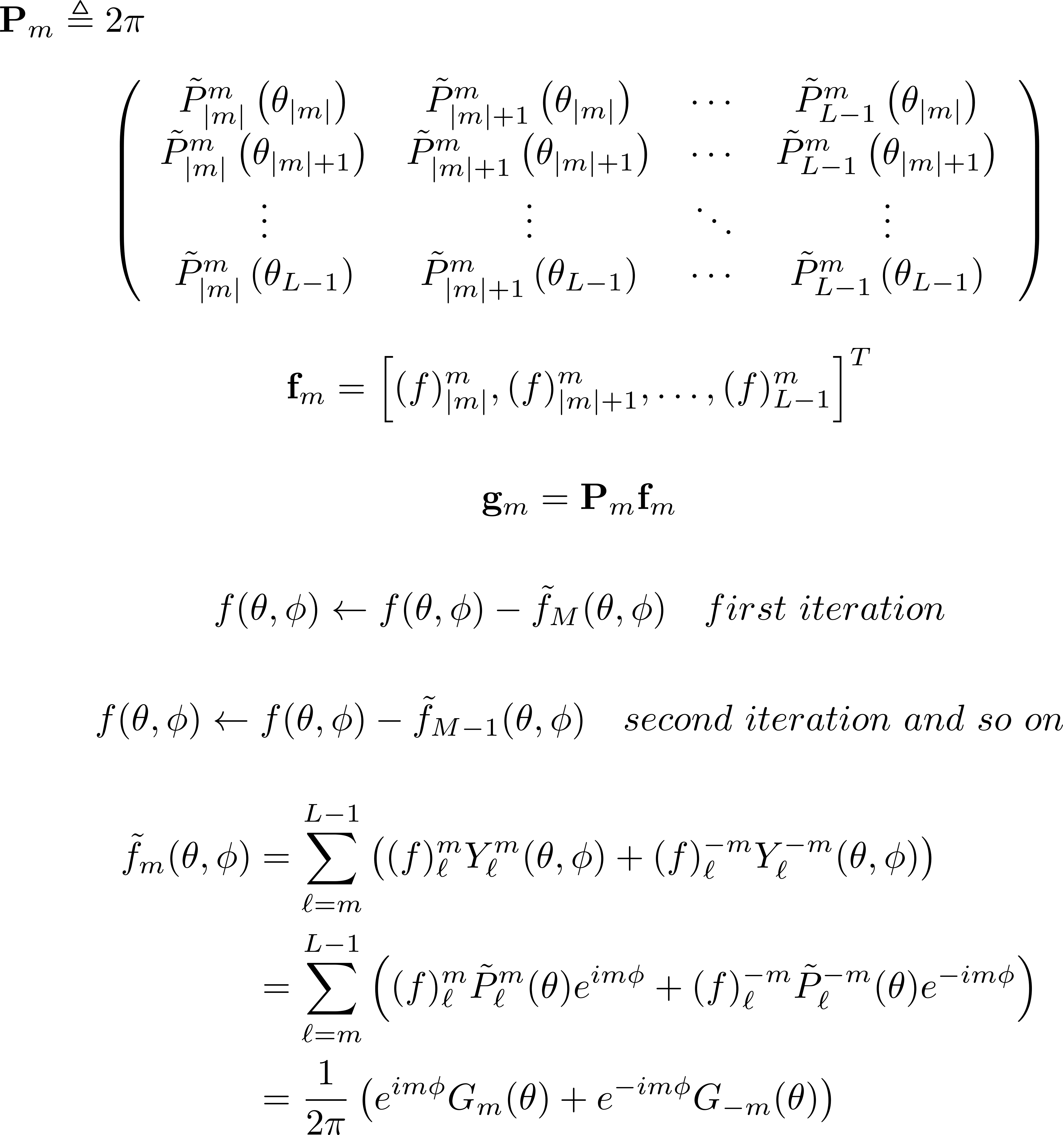
Mathematical Formulation (continued)
polynomial
functions
coefficient
vector
order
contributions

Slide 38
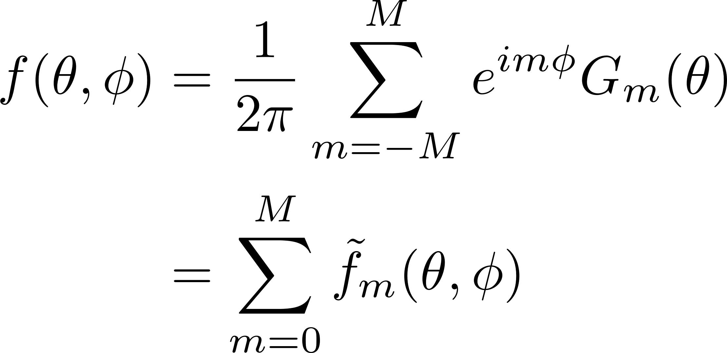
Mathematical Formulation (continued)
synthesis
equation

Slide 39
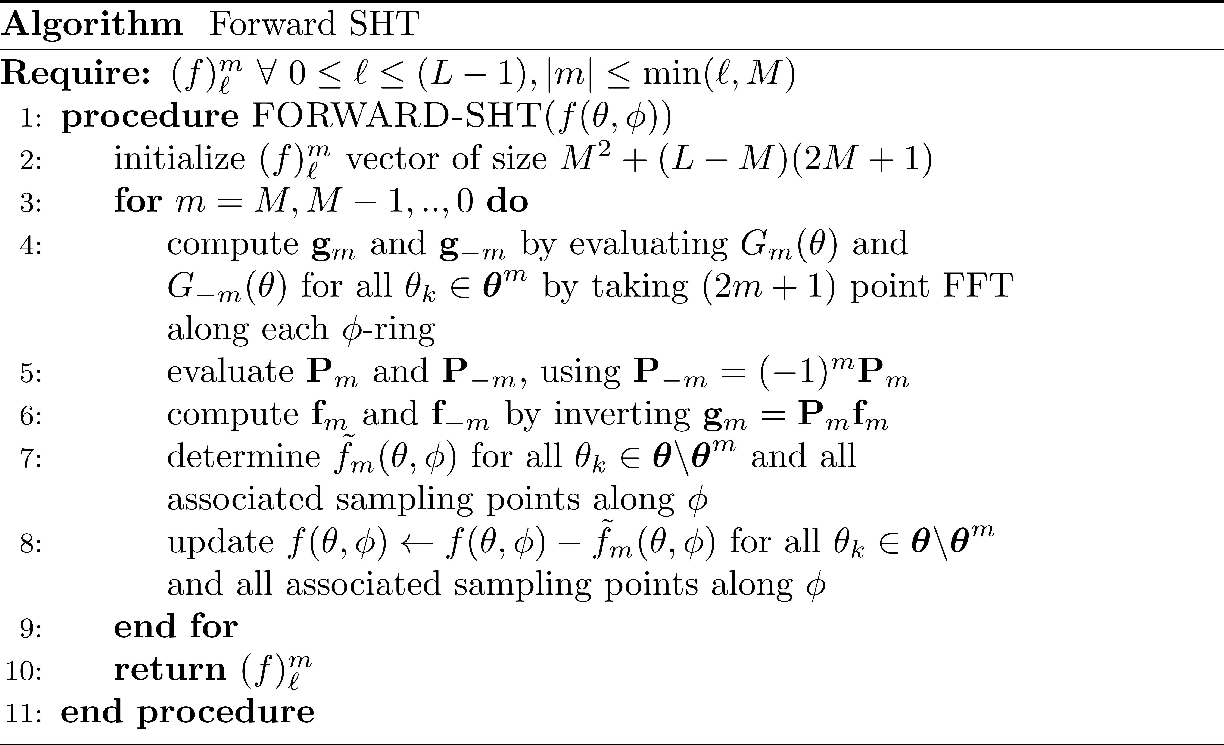
Algorithm (Forward)

Slide 40
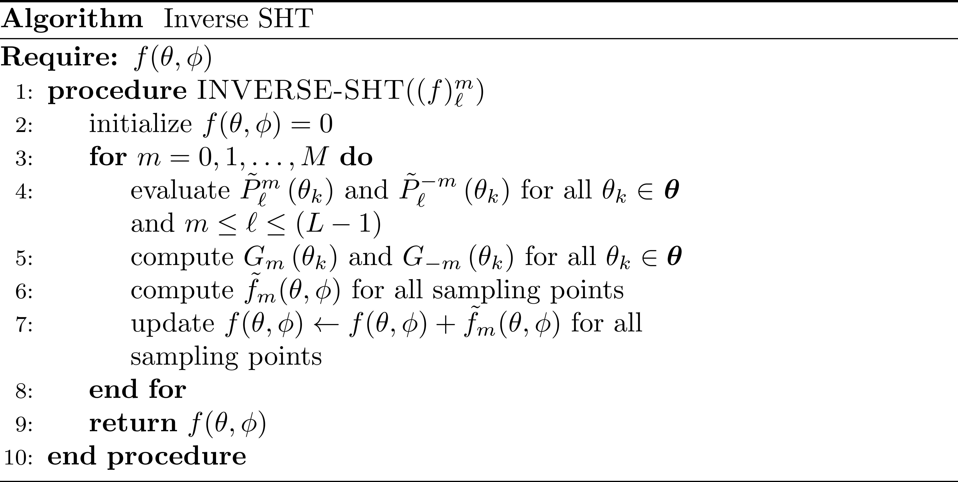
Algorithm (Inverse)

Slide 41
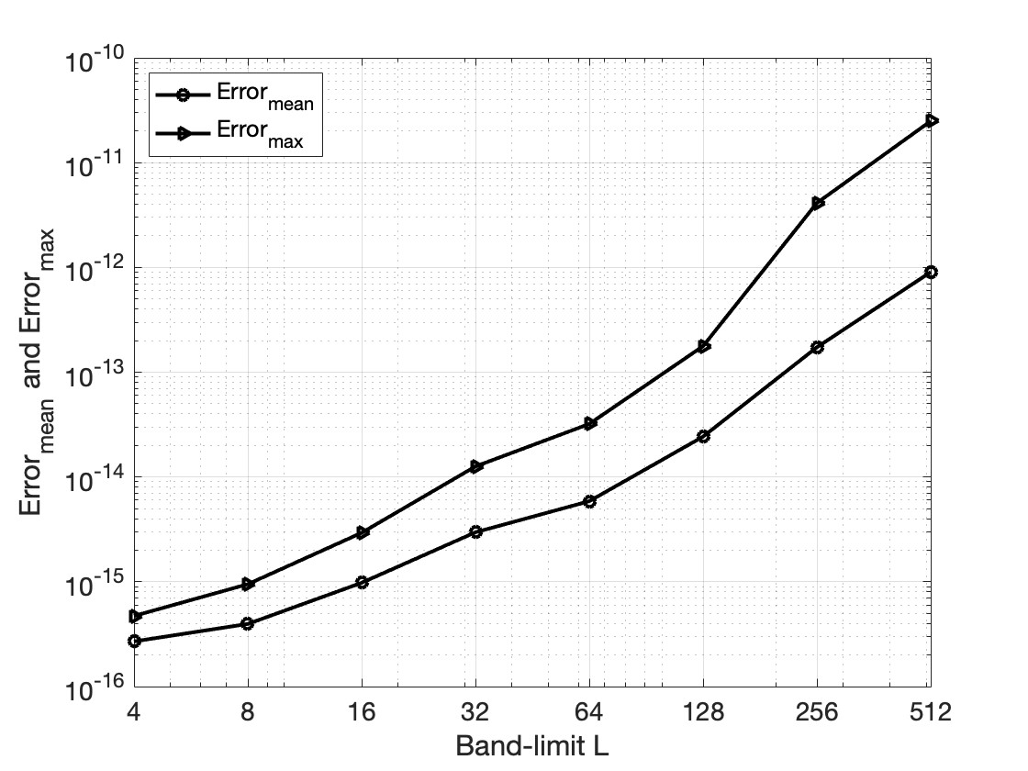
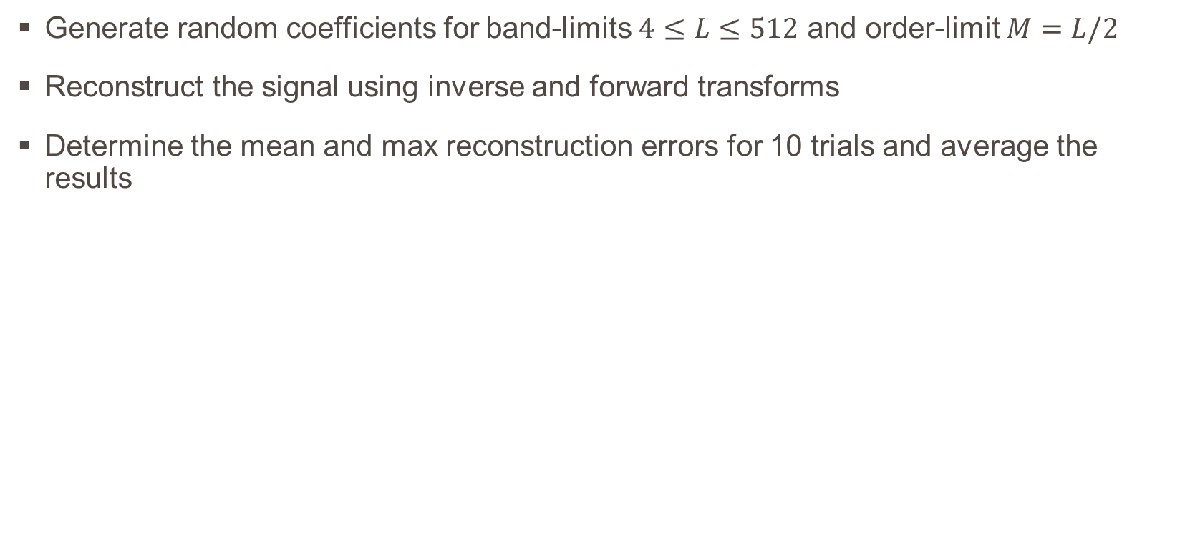
Numerical Accuracy Analysis
Generate random coefficients for band-limits $4≤L≤512$ and order-limit $M=L/2$
Reconstruct the signal using inverse and forward transforms
Determine the mean and max reconstruction errors for 10 trials and average the results

Slide 42
Application: Antenna Radiation Pattern

Slide 43
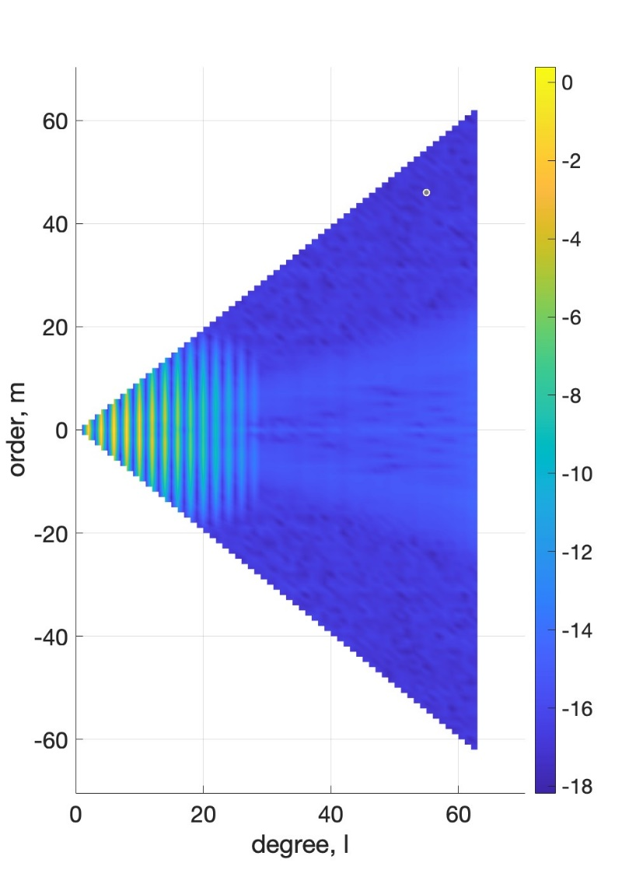
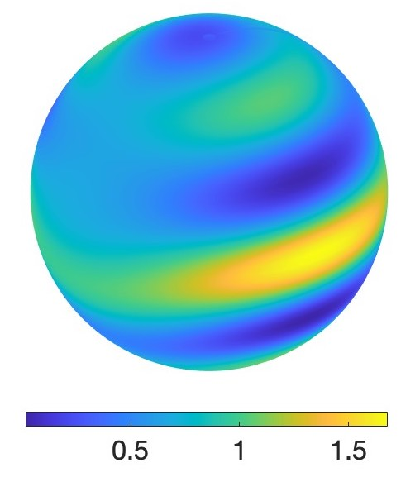
NAS Antenna Model (Spatial)
NAS Antenna Model (Spectral)

Slide 44
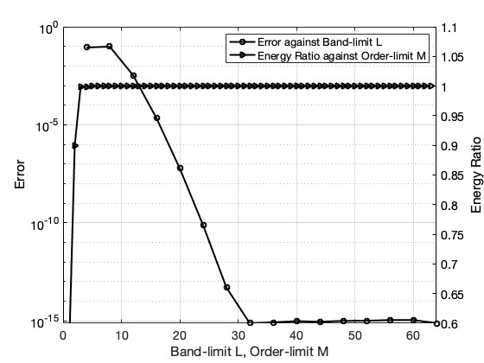
Effective Order-limit
Effective band-limit is when reconstruction error becomes constant
Effective order-limit is when energy ratio gets very close to 1
In this case, L_{eff} = 32, M_{eff} = 5
Signal reconstruction at L = 32, M = 5 results in error of the order 10⁻¹⁶

Slide 45
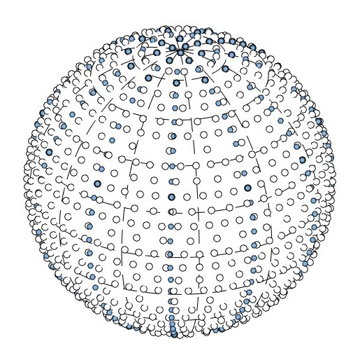
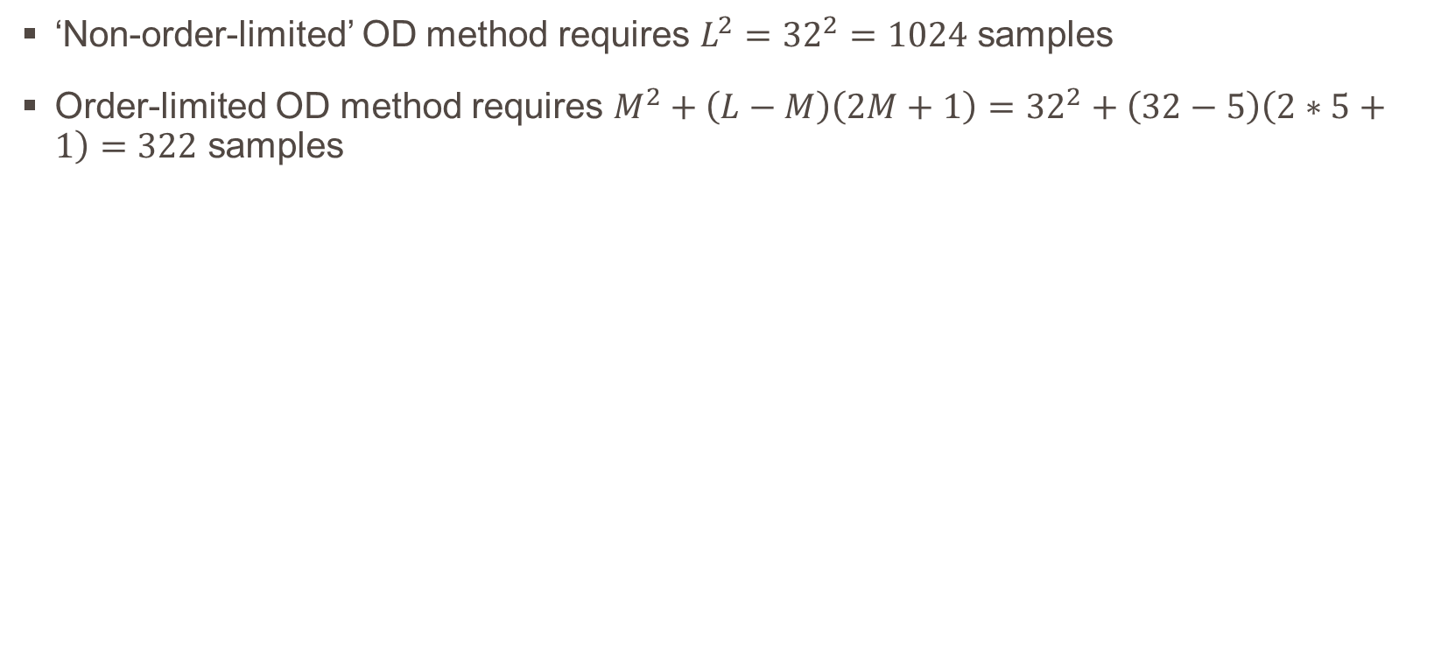
Number of samples reduced
‘Non-order-limited’ OD method requires $L^{2}={32}^{2}=1024$ samples
Order-limited OD method requires $M^{2}+\left(L−M\right)\left(2M+1\right)={32}^{2}+\left(32−5\right)\left(2∗5+1\right)=322$ samples

Slide 46
summary
Notes:
NOTE:
To change the image on this slide, select the picture and delete it. Then click the Pictures icon in the placeholder to insert your own image.

Slide 47
Summary
This work explored the problem of order-limited sampling in the spherical domain
Nearly azimuthally symmetric (NAS) signals do not have dependence on higher orders
We showed that by clipping the spectral order of NAS signals, the required number of samples can be reduced
The accuracies of the proposed transforms were tested by multiple trials of random signal reconstruction
The proposed transforms were tested on an axis-symmetric antenna model, thus proving its validity

Slide 48
Q & a
Notes:
NOTE:
To change the image on this slide, select the picture and delete it. Then click the Pictures icon in the placeholder to insert your own image.

